Slide 1

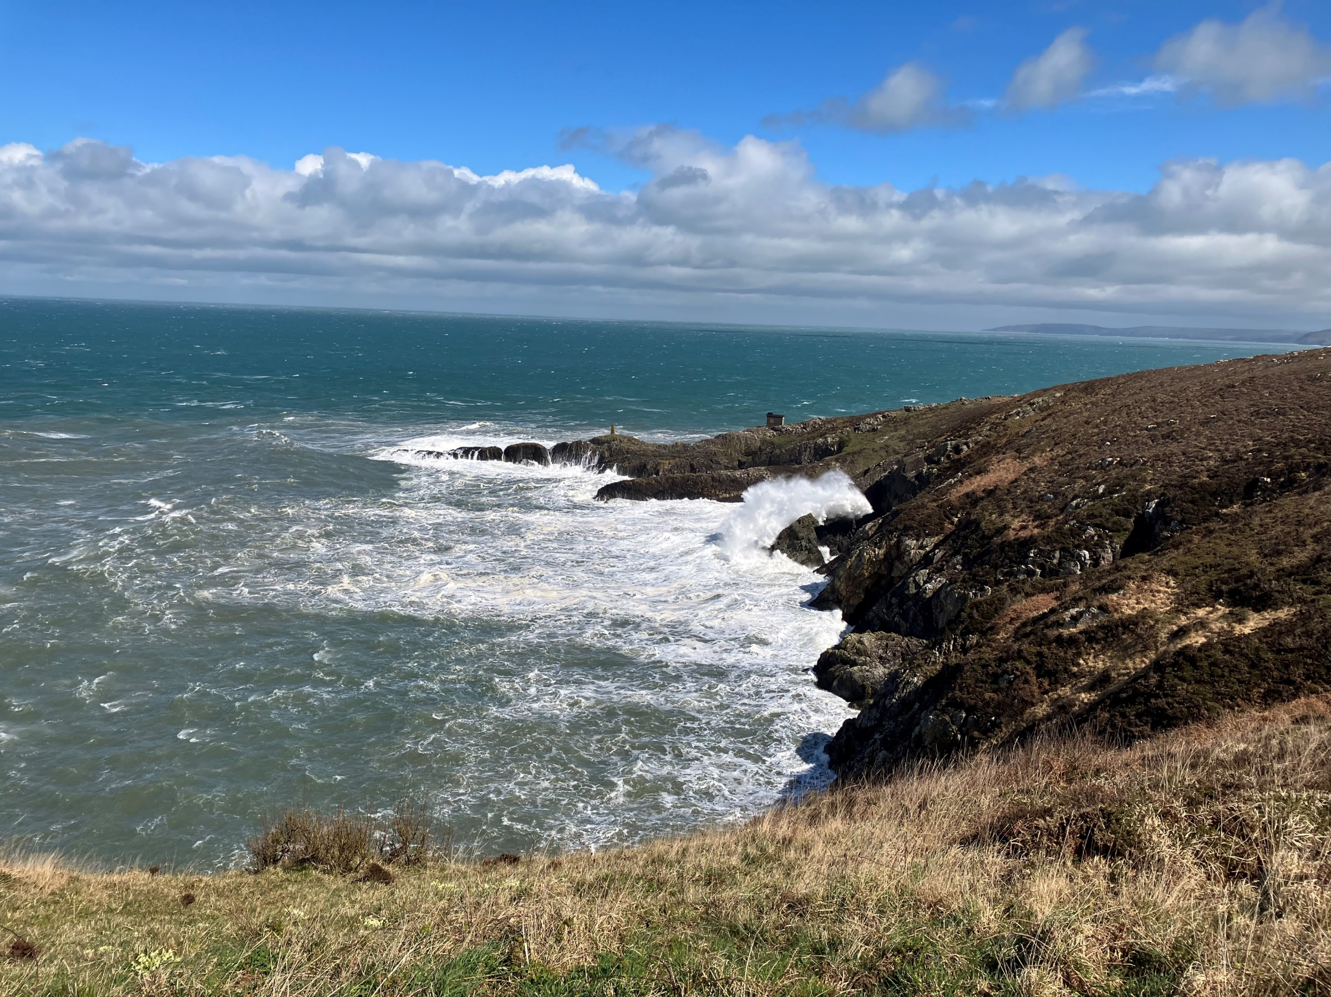
Department of Earth and Environmental Sciences
Year 1 Easter Field Course: Pembrokeshire

Slide 2
Staff
Ian Kane – fieldtrip leader - ian.kane@manchester.ac.uk
Greg Holland
Maisie Gamble
Alex Riddell
Mandy Edwards
Rufus Brunt

Slide 3
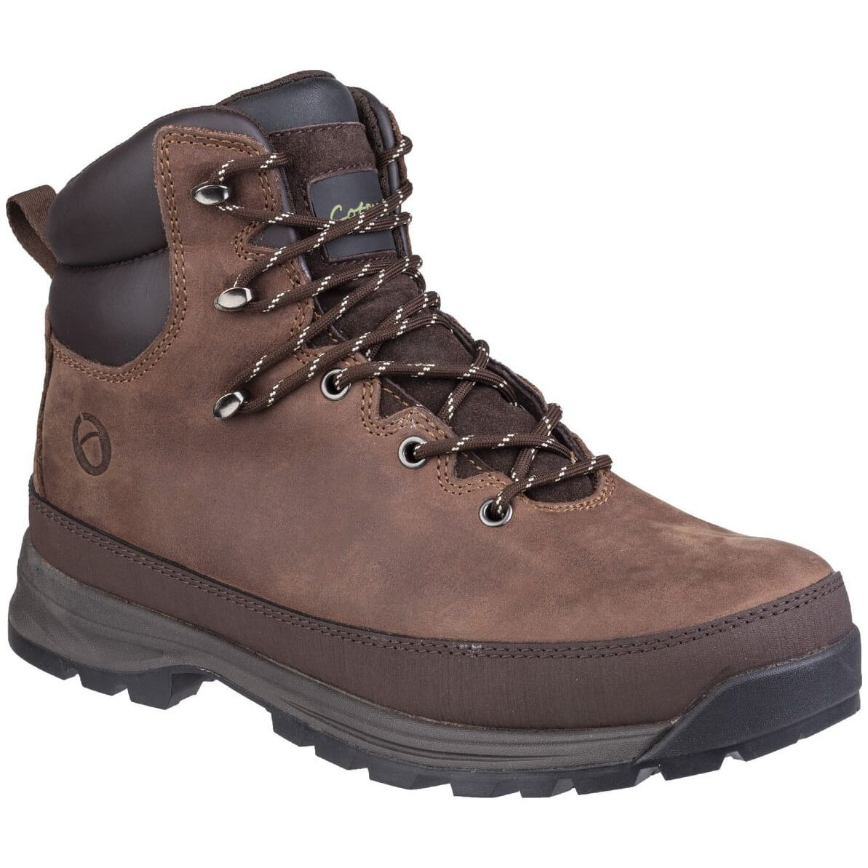
Essential Equipment
A BOOT
Sturdy Walking Boots
Waterproof Jacket and Trousers
Warm Layers
Water Bottle and optional Thermos flask
Sun hat and sun screen
Rucksack (not shoulder bag or Tesco’s carrier bag)
Pencils HB and 2H
Coloured pencils (waterproof type)
Ruler and protractor
Yellow Field Note Book

Slide 4

Essential Equipment
NOT A BOOT
Sturdy Walking Boots
Waterproof Jacket and Trousers
Warm Layers
Water Bottle and optional Thermos flask
Sun hat and sun screen
Rucksack (not shoulder bag or Tesco’s carrier bag)
Pencils HB and 2H
Coloured pencils (waterproof type)
Ruler and protractor
Yellow Field Note Book

Slide 5
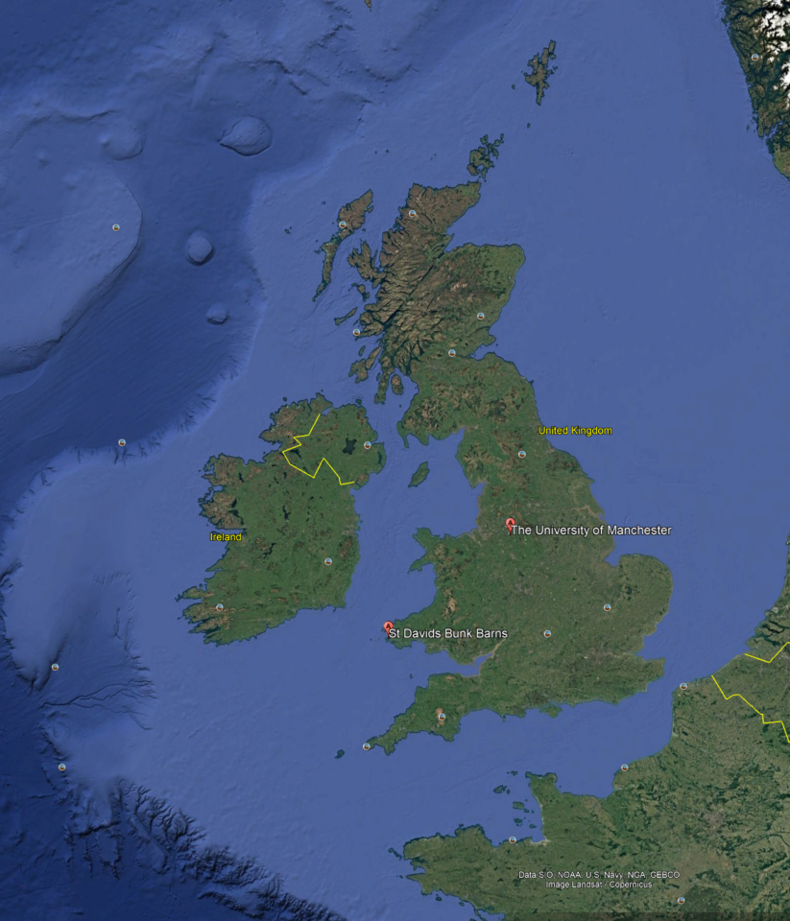
Location
South-West tip of Wales
Drive from Manchester to St David’s Bunk Barns will take ~5 hours. We will stop for lunch on the way.
We’ll drive to the localities every day

Slide 6
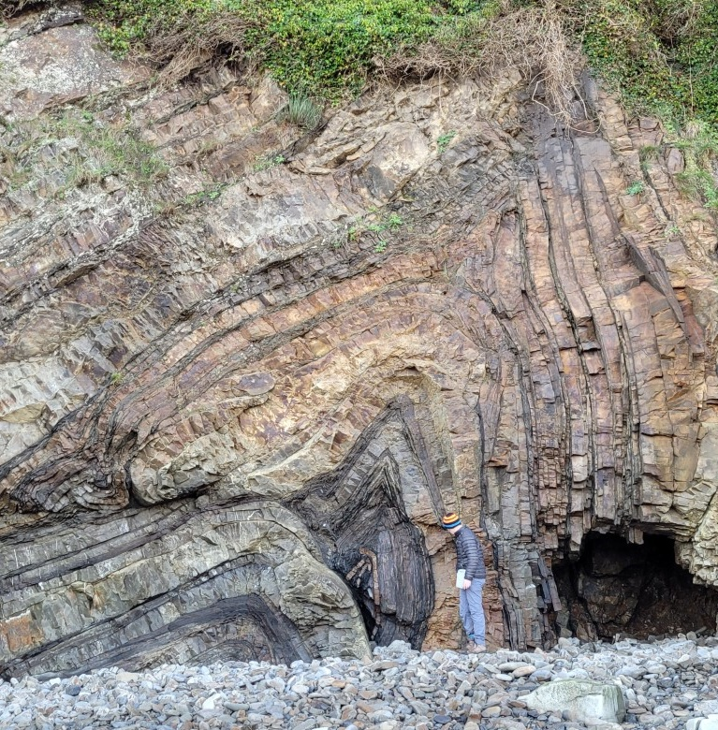
Terrain
Beaches and rocky shorelines
(uneven) coastal paths
On top and below cliffs
What risks are present here?

Slide 7
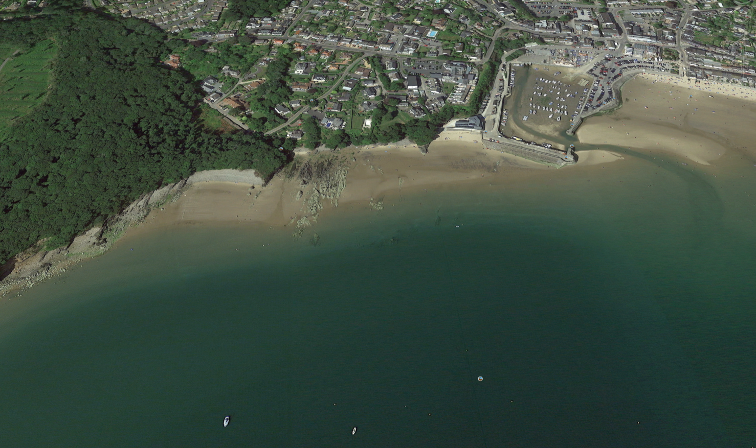
Tuesday - Saundersfoot

Slide 8
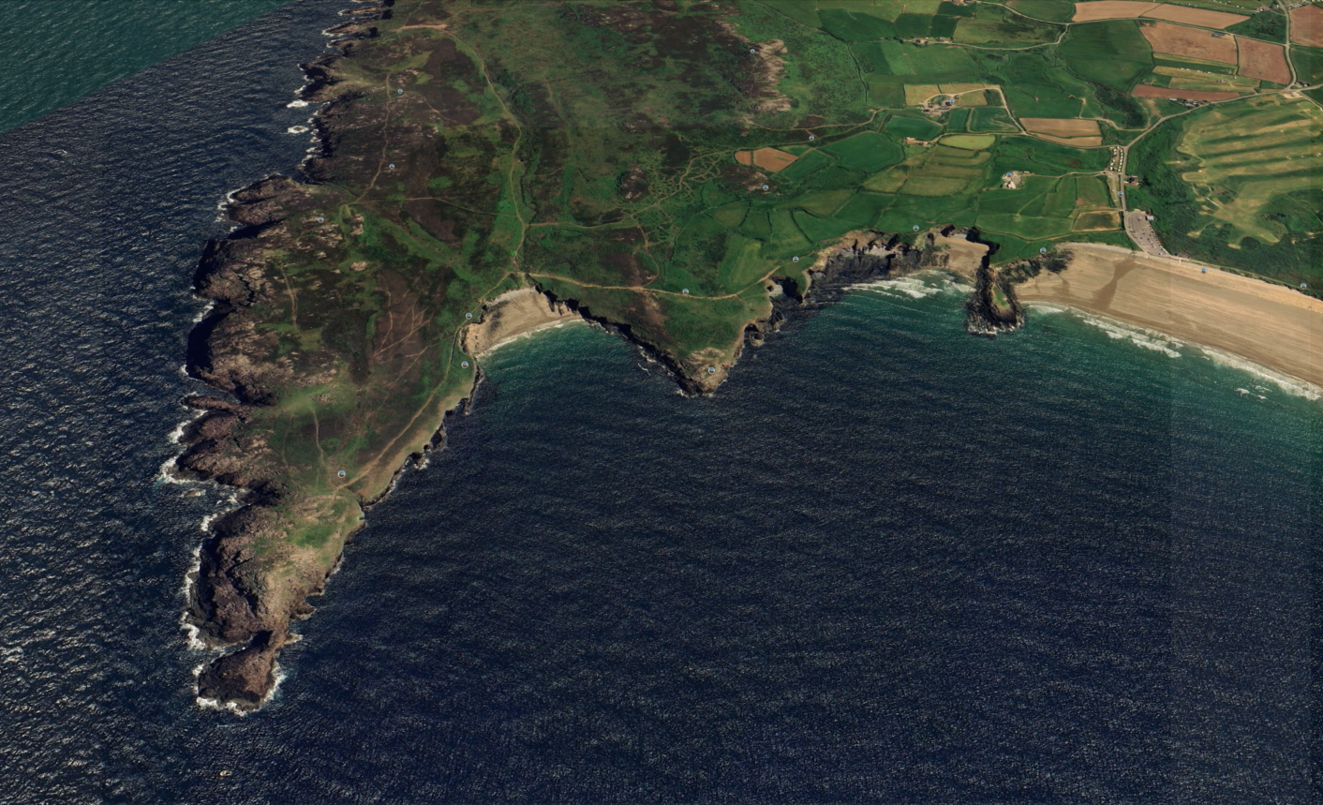
Wed-Fri - St David’s Head

Slide 9
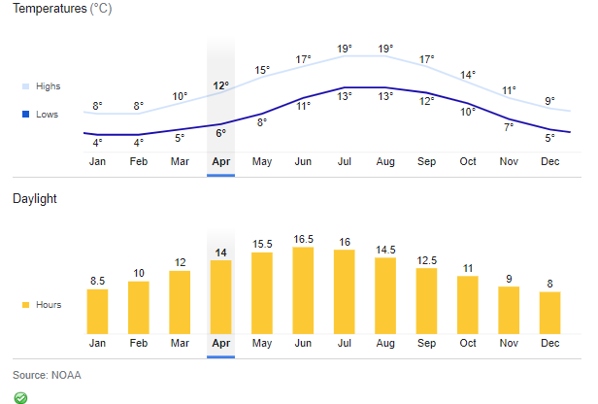
Weather
Average peak temp in April 12°C
But there can be significant wind chill
Strong winds
14 hour of Daylight

Slide 10
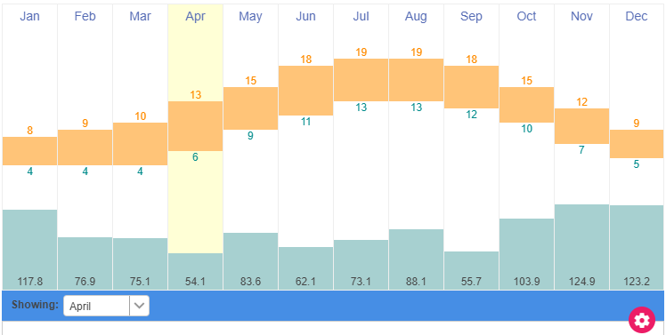
Rainfall
April Driest Month!

Slide 11
Health and Safety
Hazards
  Exposure (cold and sun)
  Falling objects from cliffs
  You falling / slipping
  Cut off by tide
Mitigation
  Wear correct clothing
  Wear Helmet
  Take care go at your own pace
  Be aware of state of tide and escape points
Biggest risk is normally due to excessive alcohol intake in evenings. So do not drink too much - and look after each other
Alcohol is NOT to be consumed in the field. You will be sent home!
Who is Responsible for Safety?
Read Risk Assessment!
On EART11300 BB site
Sign off you have read it
Fill out Medical Information Form.

Slide 12
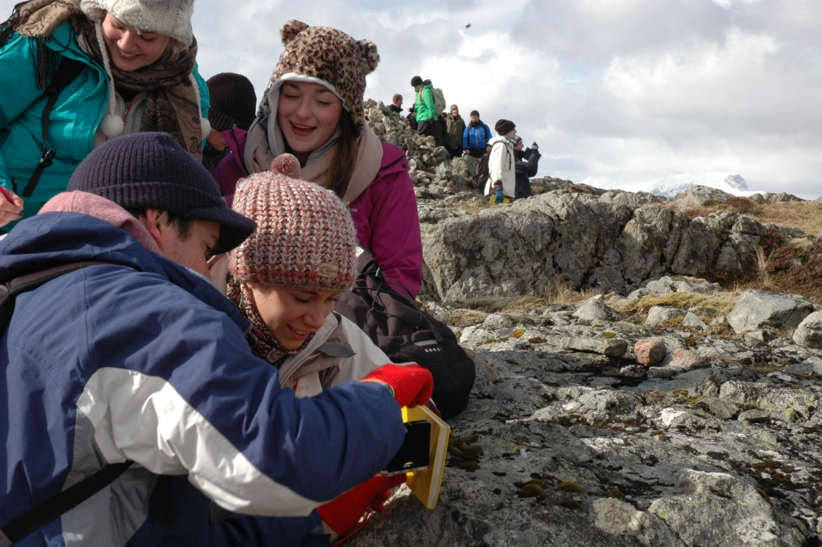
What will we be doing?
Learning Outcomes
  Geological field data collection methods
  Recording geological data in your notebook and maps
  Making observations and interpretations and recording them in your notebook and maps

Slide 13
Daily Itinerary
Breakfast from 7?
We will be out all day 9-5 depending on tide.
Packed lunch provided
Usually public toilet facilities available where we are dropped off and picked up.
Evening Meal
Some evening activity
Field courses are intense
You may feel stressed
We will be living close to one another
Therefore we all need to be kind and considerate of each other.

Slide 14

Departure
Meet in front of Museum for 0.900 departure on Monday 7th April
Load bags to Coach (Don’t bring too big a bag)
Travel to St David’s, ETA 15:30 to 16:00

Slide 15
Return
Leave St David’s Bunk Barns at 0.900 departure on Saturday 12th April
Travel to Manchester, ETA 15:30 to 16:00

